Slide 1

Action Geometry
Theory & Practice
Rick Baldassin and Nick Gravagne
Tucson 2019
40 min to 1 hour

Slide 2
Why we analyze actions
The primary goal in evaluating a piano action is to discover the relationship of the action’s leverages to a range of complimenting hammer weights and key leads.
Secondarily, professional piano technicians should be grounded in the basics of action geometry, its nomenclature and typical ranges of ratio number.

Slide 3
Why we analyze actions
The primary goal in evaluating a piano action is to discover the relationship of the action’s leverages to a range of complimenting hammer weights and key leads.
Secondarily, professional piano technicians should be grounded in the basics of action geometry, its nomenclature and typical ranges of ratio number.

Slide 4
Two main considerations when reworking a grand action
Regulation
Action must regulate to 10 mm dip (+/-)
With reasonable blow of 46 mm (+/-)
With reasonable letoff of 2 mm max
With 1.25 mm aftertouch (+/-)

Slide 5
2. Mass Re hammers and key leads
Controlling key leading and hammer weights (acceptable inertia follows).
DW and UW targets met and controlled to within acceptable limits (i.e., avg. 50 grams DW and 20 grams minimum UW).

Slide 6
The 5:1 Action Ratio to the Rescue!
In broad strokes, both considerations are satisfied when the AR is 5:1, and when the existing (i.e. factory) hammers or replacement hammers are of suitable weight (i.e. not too heavy).
This brief overview sums up not only this class, but also the focal point of our practical action rebuilding work.

Slide 7
Basic Blocks of Analysis and Decisions
Measure for the Standard Action Ratio (AR)
Adjust AR to ~5:1 ratio per Spreadsheet
Measure for the Mass Action Ratio (AR)
Calculate for Max_Allowable Strikeweight (SW)

Slide 8

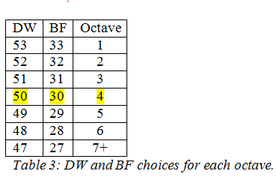
Strikeweight (SW) maximum calculations

Slide 9
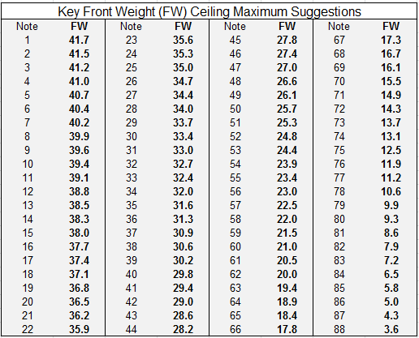

Slide 10
SWmaxA49 = (26.1 + 30) / 5.65
= 56.1 / 5.65
SWmax = 9.9
Hammer = 9.9 – 1.5 = 8.4 grams
SWmax = (26.1 + 30) / 5
= 56.1 / 5
SWmax = 11.2
Hammer = 9.9 – 1.5 = 9.7 grams

Slide 11
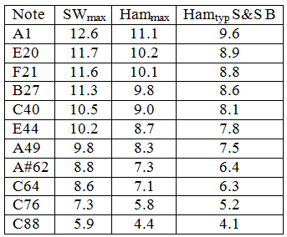
Strikeweight (SW) maximums compared to typical new hammers

Slide 12
Leverages and ratios
So what is a ratio?
And what is a leverage?

Slide 13
What is a ratio?
1 c
2 c
OJ
AJ
What is the ratio of orange juice to apple juice?
1 cup of orange juice to 2 cups of apple juice is a 1 to 2 ratio.

Slide 14

What is a ratio?
24 inches
8 inches
What is the ratio of the long stick to the short one?
24” to 8” or 24/8 or reduced is 3:1 meaning the long stick is 3 times longer than the short one.

Slide 15
Ratio point of view (PoV)
When asked for a ratio of one thing to another thing, the first thing mentioned will be the first number you write down, or the numerator (top number) of a fraction.
of
to

Slide 16
Ratio point of view (PoV)
When asked for a ratio of one thing to another thing, the first thing mentioned will be the first number you write down, or the numerator (top number) of a fraction.
For example, what is the ratio of the back segment of a piano key (120 mm) to the front segment of the key (240 mm)?
Answer 120 to 240, or 120:240, or 120/240 which reduces to 1 to 2, or 1:2, or 1/2 or simply 0.50

Slide 17
Ratio point of view (PoV) for piano actions
The correct question to ask, then, is: what is the ratio of the hammer rise (blow) to the key travel (dip) if the hammer rises 45 mm and the key travel is 9 mm?
Answer: 45 / 9 = 5

Slide 18
The Golden Action Ratio
is 5 to 1
Meaning that for every 5 mm the hammer travels up,
the key travels down1 mm

Slide 19
The Golden Action Ratio
Real world and useful parameters are 4.8 to 5.2
with 5 being a nominal benchmark

Slide 20
The Distance Action Ratio (DAR)
DAR = Radial Out Arms ÷ Radial In Arms

Slide 21
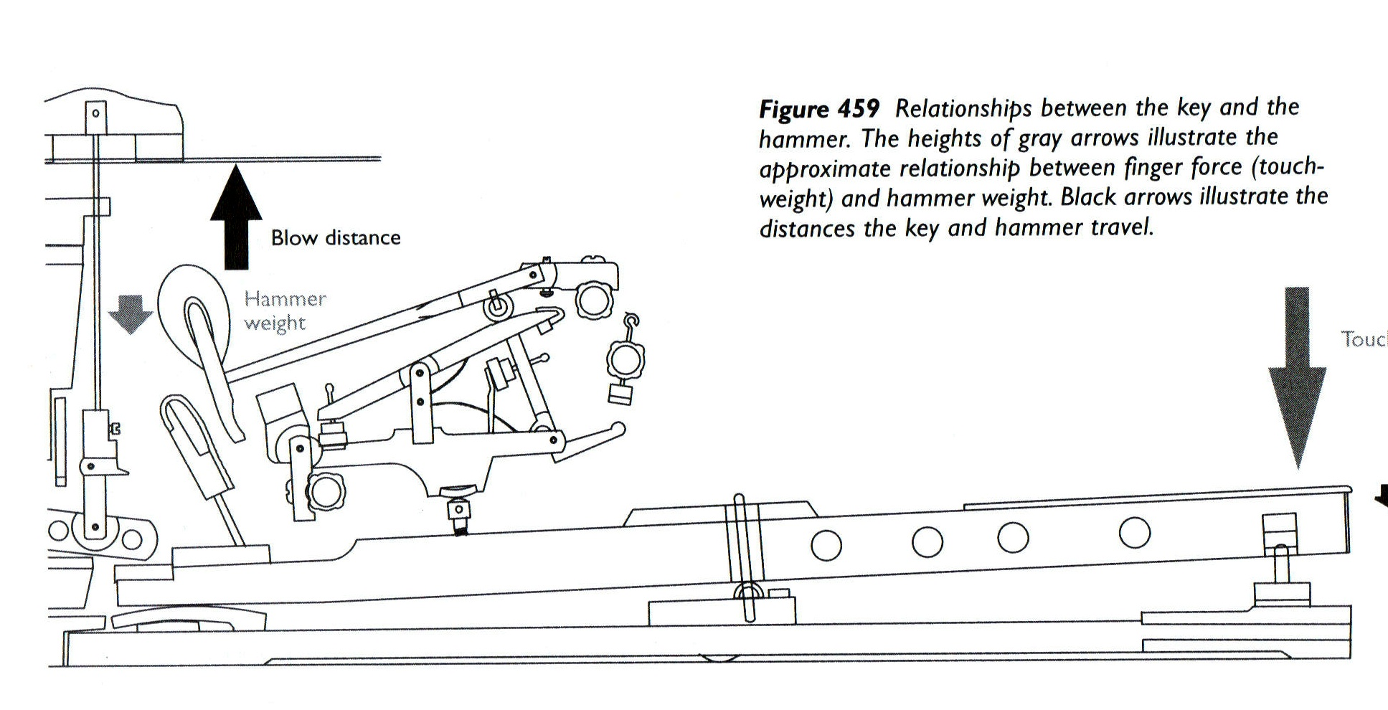
Distance Action Ration DAR Radial Arms Layouts
Shank Out
Shank In
Whip Out
Key Out
Key In
Whip In

Slide 22
Schematic View DAR Radial Arms Layouts
Shank Out 138
Shank In 21.4
Whip Out 92
Key Out 143
Key In 260 mm
Whip In 66
Go to ActGeoCompMeasure PP

Slide 23
The Simple DAR Math
Key_O / Key_I 143 / 260 = 0.55
Whip_O / Whip_I 92 / 66 = 1.40
Shank_O / Shank_I 138 / 21.4 = 6.45
NEXT Multiply the component ratios to get the Composite AR:
DAR = 0.55 x 1.40 x 6.45 = 4.97
Notes:
OPEN HO w/ calculator

Slide 24
Distance Action Ration DAR Radial Arms Layouts
What is the significance of the Radial Arms?
Why do we measure on the diagonal?
Shank Out
Shank In
Whip Out
Key Out
Key In
Whip In

Slide 25
How and why we layout and measure the action parts
It’s all about the circles, man!

Slide 26
How and why we lay and measure the action parts
B
D
F
E
C
A

Slide 27
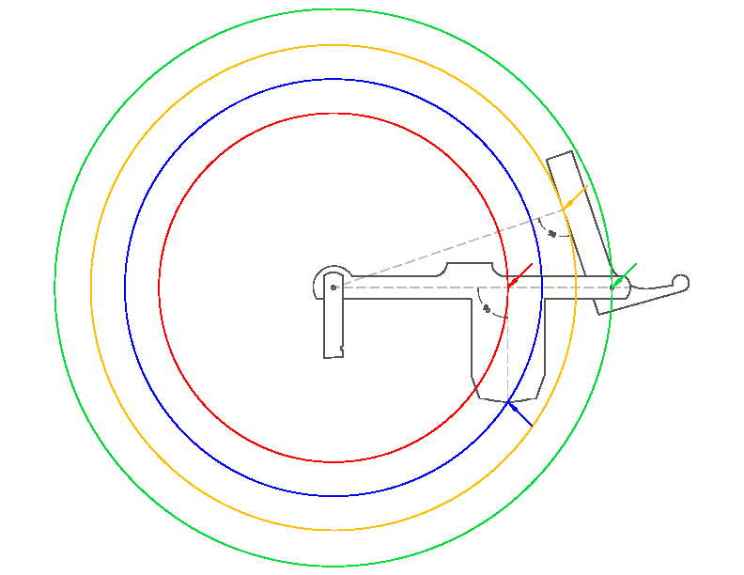
Whip Circles
Drawing by Robert Springer, RPT

Slide 28
Whip Circles
Drawing by Robert Springer, RPT

Slide 29
Whip Circles
Drawing by Robert Springer, RPT

Slide 30
Whip Circles
Slowest Runner covers least distance.
Fastest Runner covers more distance.
Drawing by Robert Springer, RPT

Slide 31
Schematic View of the DAR Radial Arms

Slide 32
Schematic View DAR Radial Arms Layouts
Shank Out
Shank In
Whip Out
Key Out
Key In
Whip In
Go to ActGeoCompMeasure PP

Slide 33
The Basic Action Ratio (AR)
AR = (Blow - Let-off) ÷ (Dip - Aftertouch)

Slide 34
So, what is an Action Ratio?
It is the ratio of the hammer rise
to that of the key dip.
What is a typically good and workable Action Ratio?
~4.8 to 5.2 or average ~5

Slide 35
Slide courtesy Baldassin - Teel

Slide 36
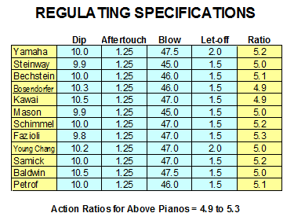

Slide 37
ACTION RATIO COMPONENTS
Key Dip Min Nom Max 9.8 10.0 10.5 | Aftertouch Min Nom Max 1.0 1.25 1.5
Blow Distance Min Nom Max 45 46.5 48 | Let-off Min Nom Max 1.0 1.5 2.0
Slide courtesy Baldassin - Teel

Slide 38
ACTION RATIO
(Blow Distance - Let-off) ÷ (Key Dip - Aftertouch)
(46 – 2) / (10 – 1.25)
44 / 8.75 = 5
These specifications dictate the action ratio.
Achieving this action ratio is our Primary Objective when selecting action parts for rebuilding.

Slide 39
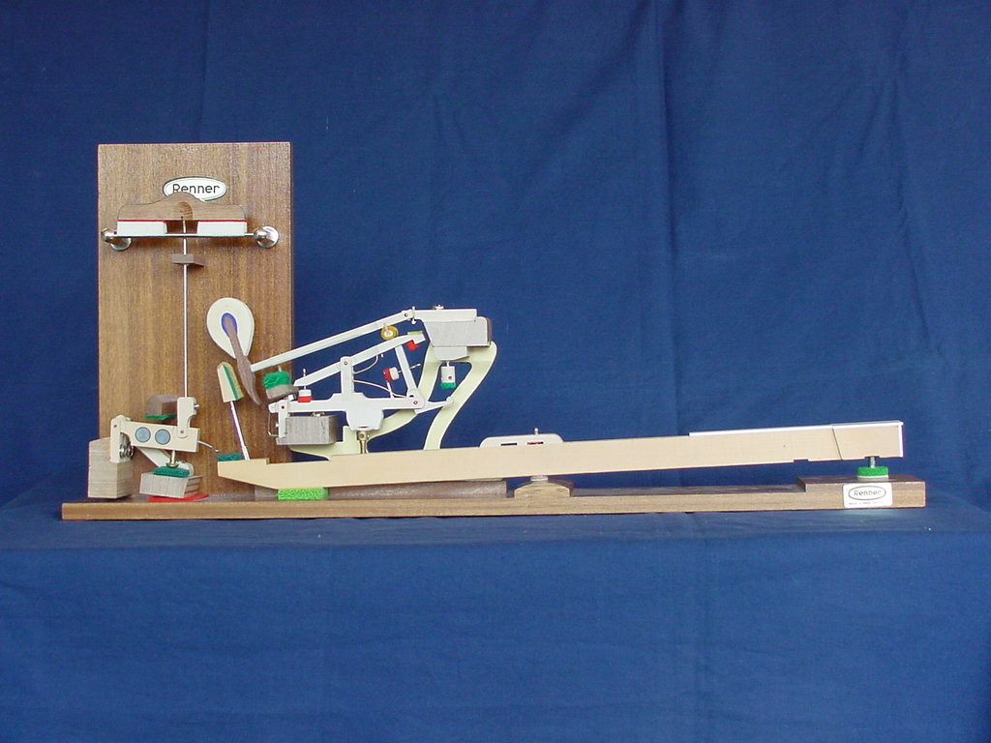
JOB DESCRIPTION for
Distance Action Ratio (DAR)
Output
44 mm
Input
8.75 mm
Move Hammer a large Specified Distance (Output) by applying a small Specified Distance (Input)

Slide 40
SIMPLE MACHINES
Output
Input
AR = (Output ÷ Input)
The relationship between the Output and the Input is called the Distance Ratio. In the piano, this is known as the Action Ratio.

Slide 41
ACTION RATIO
Blow Distance = 46 mm
Let Off = 2
Key Dip = 10
Aftertouch = 1.25
Output
BD – LO = 46 – 2 = 44
KD – AT = 10 – 1.25 = 8.75
AR = 44 / 8.75 = 5.02
Input
AR = (Output ÷ Input)
Output = Blow Distance - Let-off
Input = Key Dip - Aftertouch

Slide 42
JOB DESCRIPTION for
Action Ratio (AR)
Output
44 mm
8.75 mm
Input
Move Hammer a large Specified Distance (Output) by applying a small Specified Distance (Input)
Slide courtesy Baldassin - Teel

Slide 43
SIMPLE MATH
Output
Input
AR = (Output ÷ Input)
The relationship between the Output and the Input is called the Distance Ratio. In the piano, this is known as the Action Ratio.
Slide courtesy Baldassin - Teel

Slide 44
ACTION RATIO
Blow Distance = 46 mm
Let Off = 2
Key Dip = 10
Aftertouch = 1.25
Output
B – L = 46 – 2 = 44
D – A = 10 – 1.25 = 8.75
AR = 44 / 8.75 = 5.02
Input
AR = (Output ÷ Input)
Output = Blow Distance - Let-off
Input = Key Dip – Aftertouch
Slide courtesy Baldassin - Teel

Slide 45
ACTION RATIO COMPONENTS
Key Dip Min Nom Max 9.8 10.0 10.5 | Aftertouch Min Nom Max 1.0 1.25 1.5
Blow Distance Min Nom Max 45 46.5 48 | Let-off Min Nom Max 1.0 1.5 2.0

Slide 46
ACTION RATIO
(Blow Distance - Let-off) ÷ (Key Dip - Aftertouch)
These specifications dictate the action ratio.
Achieving this action ratio is our Primary Objective when selecting action parts for rebuilding.

Slide 47
CALCULATE ACTION RATIO
(Blow Distance - Let-off) ÷ (Key Dip - Aftertouch)
(46 mm - 2 mm) ÷ (10 mm - 1.25 mm) = 5
The AR = 5

Slide 48
ACTION RATIOS
Minimum Nominal Maximum 4.8 5.0 5.2

Slide 49
The AR = DAR
AR = (Blow - Let-off) ÷ (Dip - Aftertouch) = 5
DAR = Radial Out Arms ÷Radial In Arms = 5

Slide 50
END ACTION RATIOS

Slide 51
The Mass Action Ratio
Relates to Hammer weights and key leads.

Slide 52
OK – let’s talk about leverages and mechanical advantage.

Slide 53
What is a lever?

Slide 54
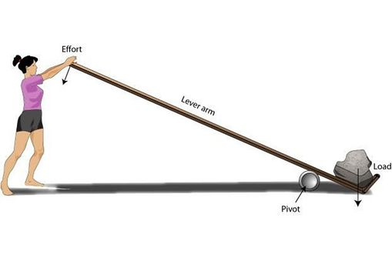
Mechanical Advantage (MA) Positive
How could we view this setup as a negative MA?
Small 10 lb. Effort here.
Lifts large 60 lb. Load here.
What can we perceive about the distances moved at the effort end, and at the load end?
Wip demo and key demo

Slide 55
JOB DESCRIPTION
Output
9
50 grams
Input
Move a Mass (Output) by applying a Force (Input)

Slide 56
Depicting the action as one long lever
Action Ratio is 5:1
44 mm
240 mm
1200 mm
8.75 mm
44 / 8.75 = 5
1200 / 240 = 5

Slide 57
REAR (OUT)
FRONT (IN)
50
50
120 mm
120 mm
10 mm
10 mm
Distance Ratio of the output to the input is 120 / 120 = 1
Mass ratio of the output to the input is
50 / 50 = 1

Slide 58
100
50
80 mm
160 mm
5 mm
10 mm
Distance Ratio of the output to the input is 80 / 160 = 0.50
Mass ratio of the output to the input is
100 / 50 = 2

Slide 59
150
50
60 mm
180 mm
~3 mm
10 mm
Distance Ratio of the output to the input is 60 / 180 = 0.33
Mass ratio of the output to the input is
150 / 50 = 3

Slide 60
The Hammer and Key Leads (key in balance)
hammer
Action Ratio = Internal leverages
(inc. friction)
DW= 50g
10 g

Slide 61
Depicting the action as one long lever
Action Ratio = 5:1
Because ratio of hammer rise to dip = 44 / 8.75= 5
44 mm
50
10 g
8.75 mm
Mass Ratio = 1:5
Because ratio of hammer weight to DW = 10 / 50 = 0.20

Slide 62
Depicting the action as one long lever
Action Ratio = 6:1
Because ratio of hammer rise to dip = 53 / 8.75= 6
53 mm
50
8.3 g
8.75 mm
Mass Ratio = 1:6
Because ratio of hammer weight to DW = 8.3 / 50 = 0.17

Slide 63
Depicting the action as one long lever
Action Ratio = 7:1
Because ratio of hammer rise to dip = 61 / 8.75= 7
61 mm
50
7 g
Mass Ratio = 1:7
Because ratio of hammer weight to DW = 7 / 50 = 0.14
8.75 mm

Slide 64
Summary
AR MR Dip Ham Rise Ham Weight
5:1 1:5 8.75 44 10.0
6:1 1:6 “ 53 8.3
7:1 1:7 “ 61 7.0
Notice that the high AR of 7 cannot support the 10 g hammer but can support the lighter 7 g hammer. The lower AR of 5 can support the 10 g hammer.

Slide 65
Bottom Line
As the Action Ratio increased from 5:1 to 7:1 the hammer travel increased from 44 mm to 61 mm
Conclusion:
higher action ratios = more hammer travel for a given dip
lower action ratios = less hammer travel for a given dip

Slide 66
Bottom Line
As Mass Ratio decreased from 1:5 to 1:7 the balancing hammer decreased from 10 g to 7 g
Conclusion:
lower mass ratios (e.g. 5) can handle heavier hammers
higher mass ratios (e.g. 5.7) require lighter hammers

Slide 67
Measurements for the MAR
Right Angle Here
Red Arrows are Lines of Action (aka Lines of Force Vectors)

Slide 68
SO
SI
WO
KO
KI
WI

Slide 69
Schematic view
SO
SI
WO
KO
KI
WI

Slide 70
Schematic View of the Mass Action Ratio MAR Lever Arms

Slide 71
Measure two lengths on each action component.
SI = 17 mm
SO = 130
WO = 93 mm
WI = 62 mm
KI = 240 mm
KO = 120 mm

Slide 72
The Simple MAR Math
Key_O / Key_I 120 / 240 = 0.50
Whip_O / Whip_I 93 / 62 = 1.50
Shank_O / Shank_I 130 / 17 = 7.65
NEXT Multiply the component ratios to get the Composite MAR:
MAR = 0.50 x 1.50 x 7.65 = 5.74
Notes:
OPEN HO w/ calculator

Slide 73
In Physics force can be expressed as a mass and vice-versa.
68 grams force on the top of the jack
9
50 grams
100 grams

Slide 74
DAR and MAR superimposed schematic view

Slide 75
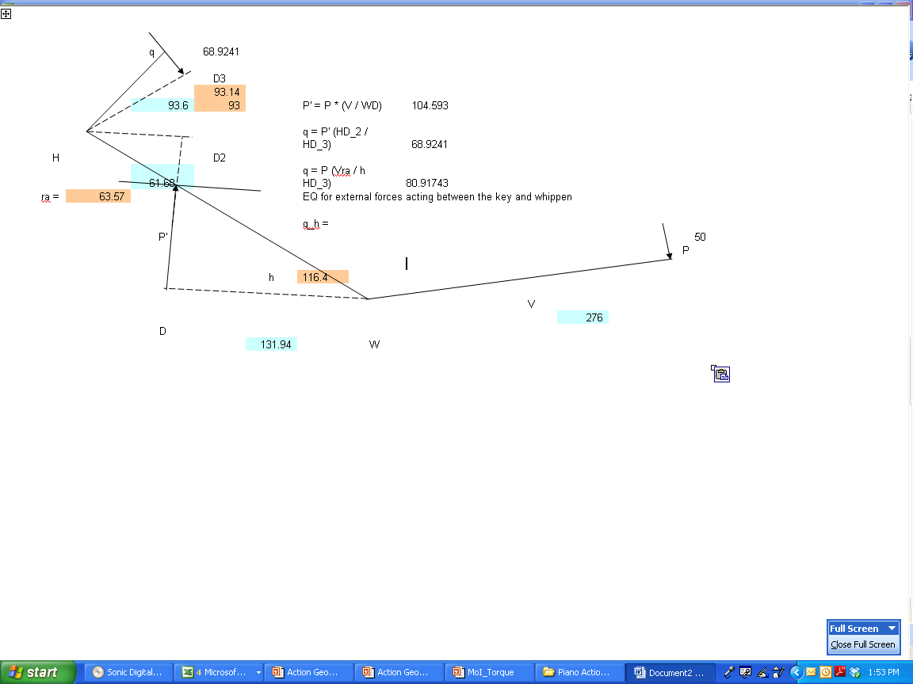
Forces develop through the system at right angles
Dr. Pfeiffer’s Lines of Action
and Moment Arms (aka Lever Arms)

Slide 76
Determine Existing Action Ratio
AKA letting the physical action tell you what the Action Ratio is!

Slide 77
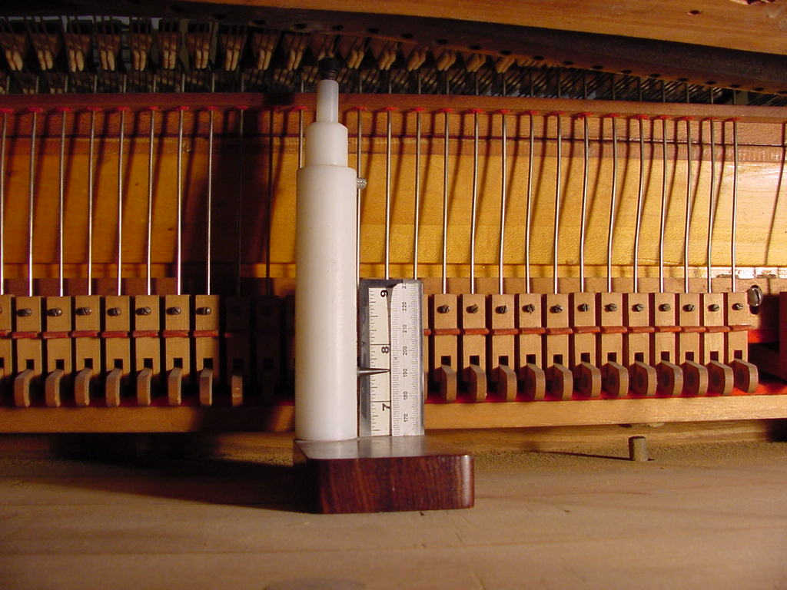
Determine Existing Action Ratio
Measure string height of several notes
But especially note C40 or E44

Slide 78
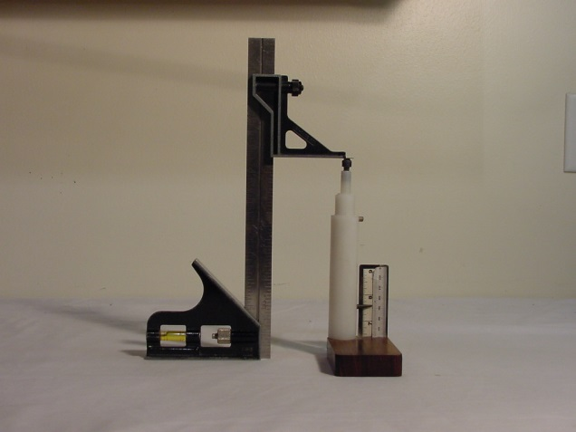
Determine Existing Action Ratio
Hi-Gage Square Attachment from Garrett Wade
Set String Height Gage

Slide 79
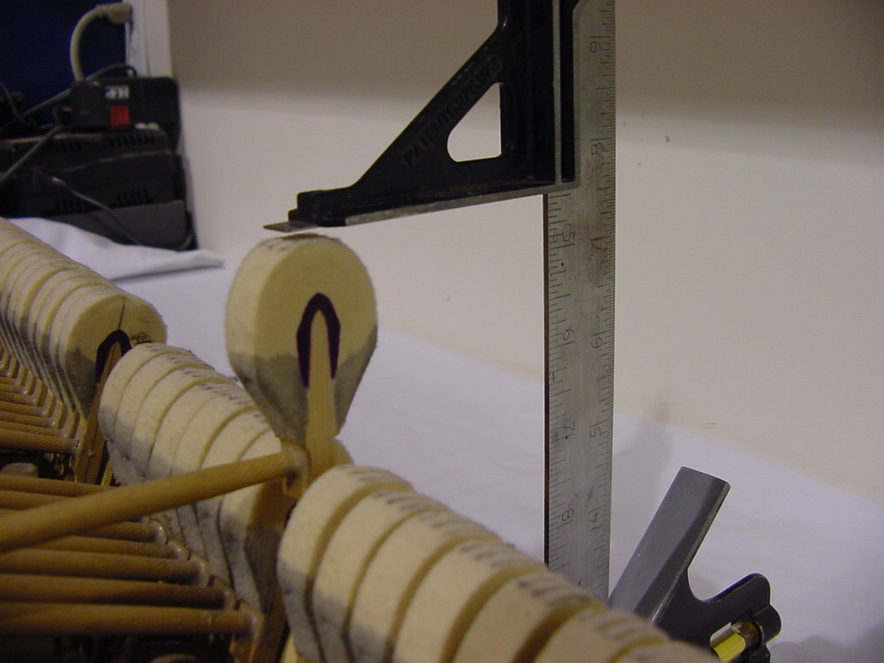
Determine Existing Action Ratio
Action is now out of the piano, sitting on a dolly / bench. Let off is being set to 2 mm or 1.5 mm
Set Let-off (2 mm)

Slide 80
Finding a Practical Action Ratio
Set letoff to 2 mm (or 1.5 mm).
Set dip to 10 mm (or other valid value).
Insert 1.25 mm aftertouch gage.
Turn capstan up or down until hammer just lets off with firm (but not crushing) pressure at the front key end.
The resulting blow is what works for this set of dip, aftertouch and letoff numbers.

Slide 81
Letoff = 2mm
Step 1 -- set letoff

Slide 82
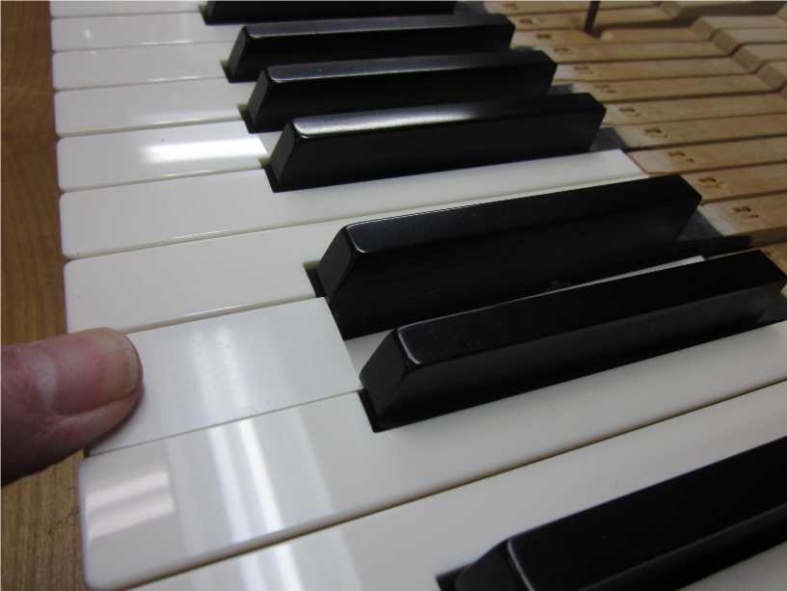
Step 2 -- set dip
10 mm dip block

Slide 83
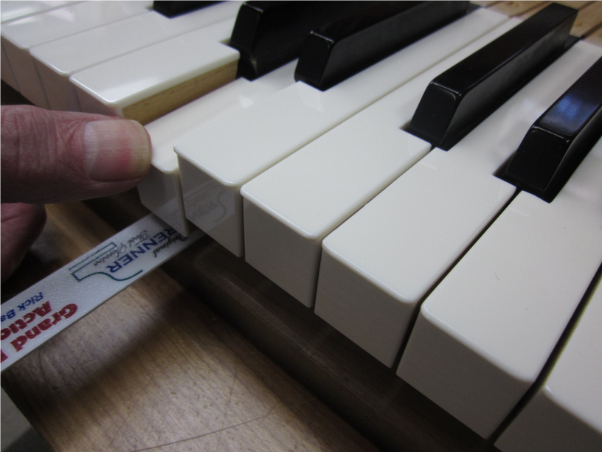
Step 3 -- insert AT gage
1.25 mm aftertouch gage

Slide 84
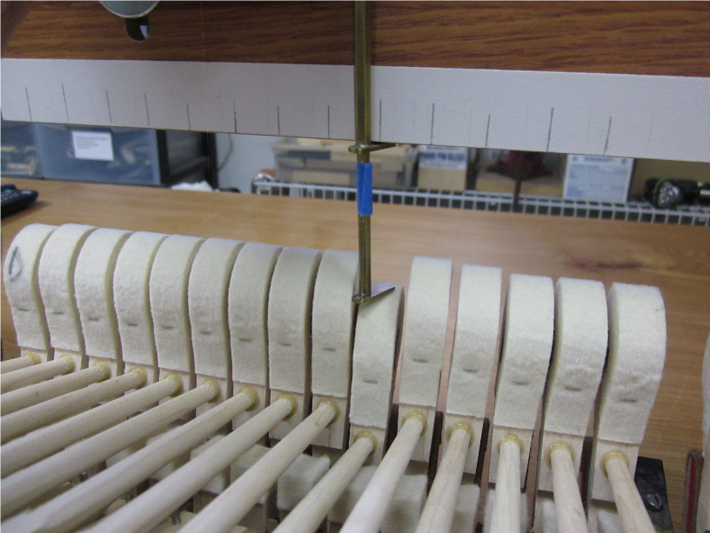
Step 4 -- adjust capstan up or down until hammer just lets off (firm pressure on key with finger).
45 mm blow
The resulting blow dimension (here 45 mm) is now a function of letoff, dip and aftertouch, and is the dimension we use in the following simple formula.

Slide 85
Here the Action Ratio is good
AR = (Blow – Let off) / (Dip – Aftertouch)
= (45 – 2) / (10 – 1.25)
= 43 / 8.75
AR = 4.91 i.e. ~ 5 ish
Range of Action Ratios: 4.80 to 5.20

Slide 86
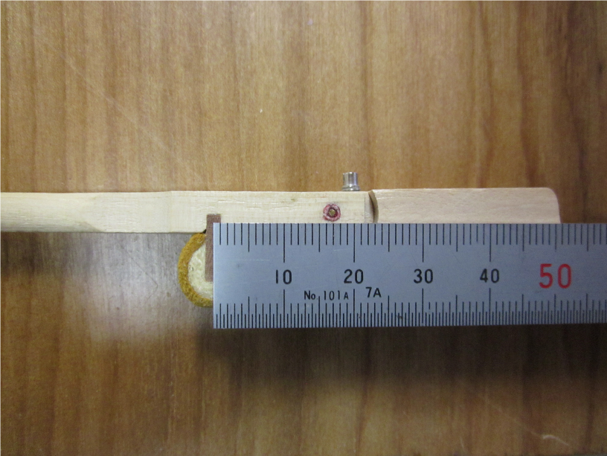
Big Red Flag for Possible Action Trouble
Short 15.5 mm knuckle distance = higher action ratio
15.5 mm
May not be able to support modern heavier hammers

Slide 87
Big Red Flag for Possible Action Trouble
130 mm
240 mm
Key ratio too long @ 130 / 240 = 0.54 or 1.85 to 1
So Higher Action ratio here!

Slide 88
Big Red Flag for Probable Action Trouble
The double-whammy of the long key ratio and the short knuckle dimension typically means that the action will not support modern hammers.
Changing the knuckle distance to 16.2 mm or 17 mm (sometimes a capstan relocation may be required) will solve the problem.
So, the very first thing to check is the key ratio and the knuckle location.

Slide 89
Big GREEN Flag for Probable Action GOOD
17 mm
120 mm
240 mm
Key ratio good @ 120 / 240 = 0.50 or 2 to 1

Slide 90
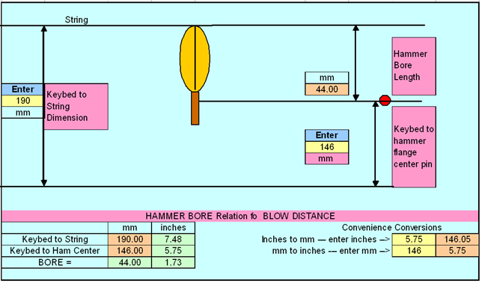
Hammer Bore Basics

Slide 91
Measure string height of several notes
But especially note C40 or E44

Slide 92
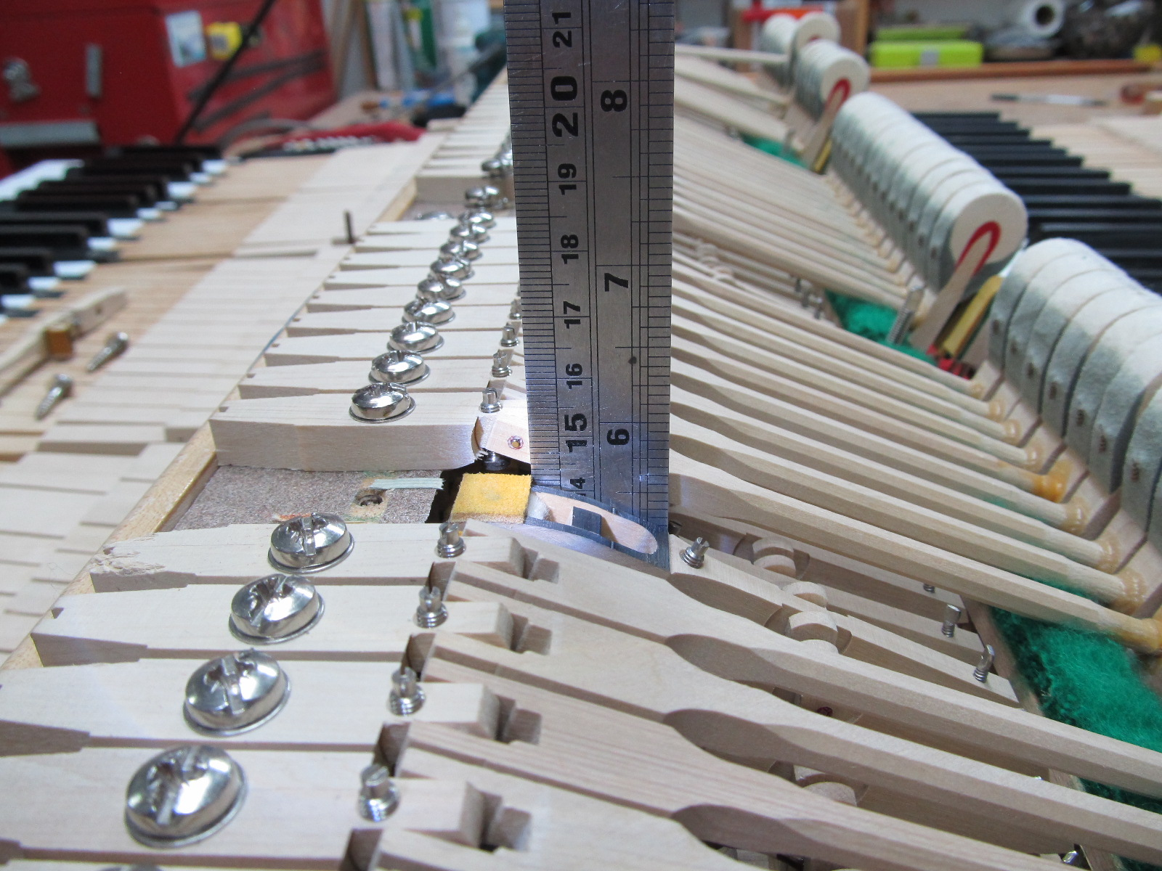
Hammer Bore Basics
148 mm from keybed to flange center

Slide 93
Hammer Bore Basics
Hammer Bore Example:
190 mm = String height off keybed
- 146 mm = Hammer flange height off flat workbench
44 mm = Hammer bore
44 mm

Slide 94
Action and String Plane Elevations
Steinway spec for action elevations:
Keybed to hammer flange center is 5.75” (146 mm)
Keybed to whippen flange center is 3.25” (82.55 mm)
Keybed to underside of capo bar at note 62 is 7.5” (190.5 mm)
  7.625” (194 mm) on the Model D
  Model D action elevations are usually higher as well as shown below regarding the Baldwin Concert grand action.

Slide 95
Using the Action Geometry Program
Take measurements
Input measurements into program
Run the program
Interpret readouts
If necessary, adjust knuckle and / or capstan location to attain target AR (e.g. 5:1)

Slide 96
Downloads
Action Program
gravagne.com/AGP_Tucson.xlsm
gravagne.com/AGPTucsonLITE.xlsx
PowerPoint
gravagne.com/TucsonPP.pptx
Key weigh off
gravagne.com/KBM.doc

Slide 97
Using the Action Geometry Program
Take measurements
  Key – two measurements
  Wippen – two measurements
  Shank – two measurements
  Action Spread – one measurement

