Slide 1
Parts Set Up and Initial Considerations
Hammer Bore Dimension
Hammer Center Line
Hammer angle to shank (90 ͦ std.)
Custom boring
Action elevations

Slide 2
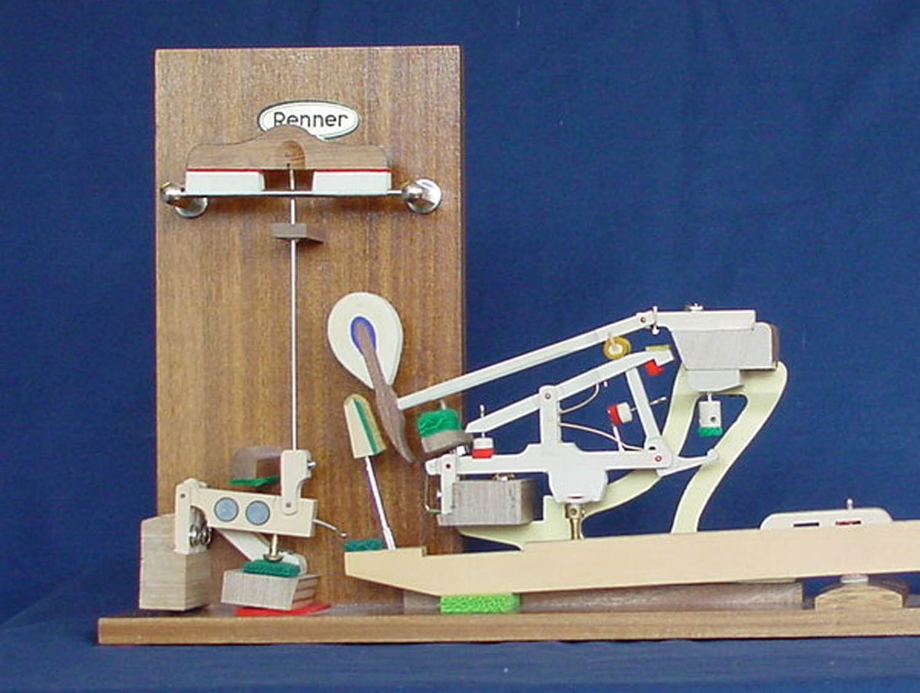
Calculate Hammer Bore Distances
String Height
Hammer Bore
Center Pin Height
Keybed
String Height – Center Pin Height = Bore Distance

Slide 3
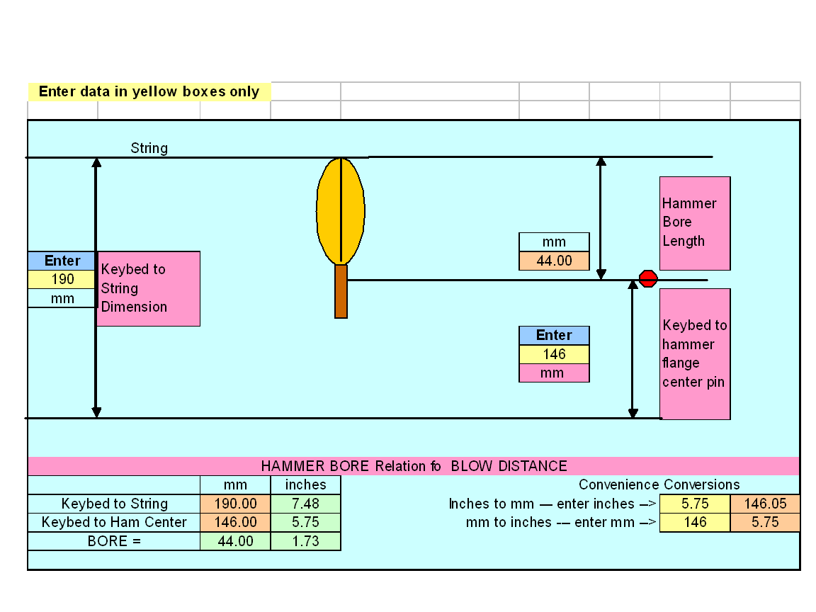

Slide 4
Custom Boring
As a function of unevenness of the string heights plane.

Slide 5
Typical Steinway String Heights

Slide 7
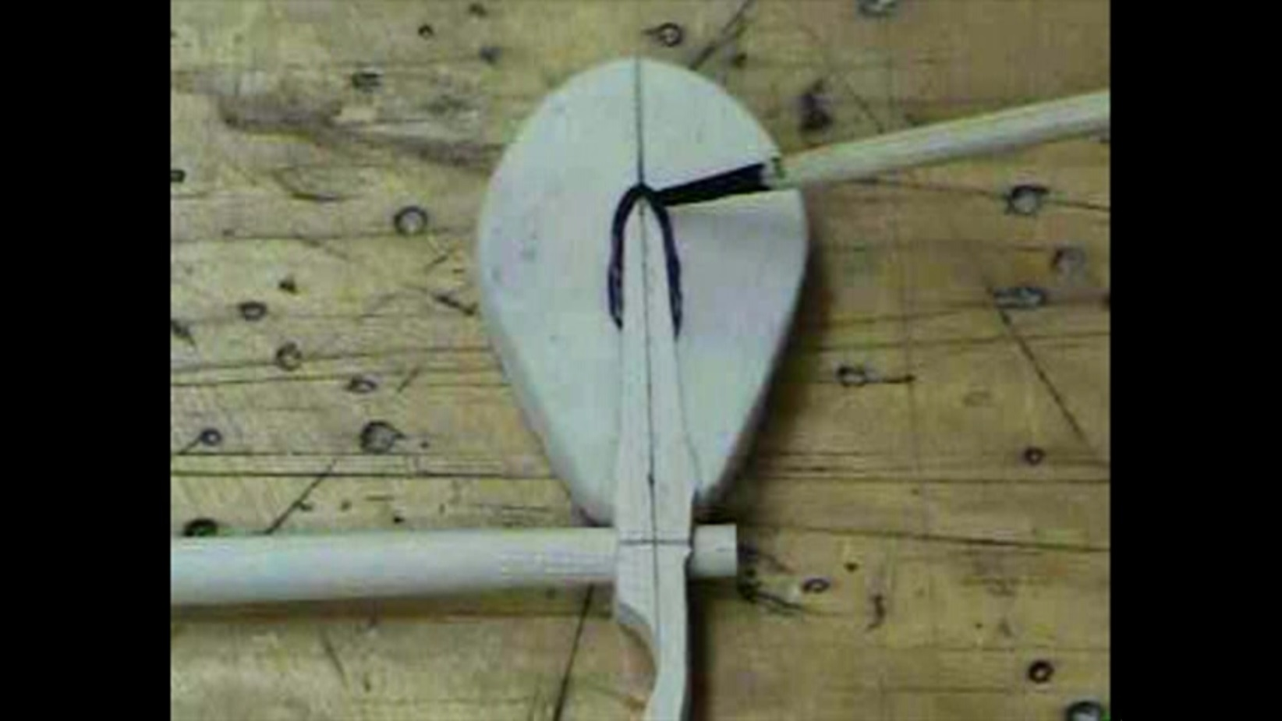
Hammers and Shanks
  Hammer CL and Strike-Point
    (movie)
90 degrees

Slide 8
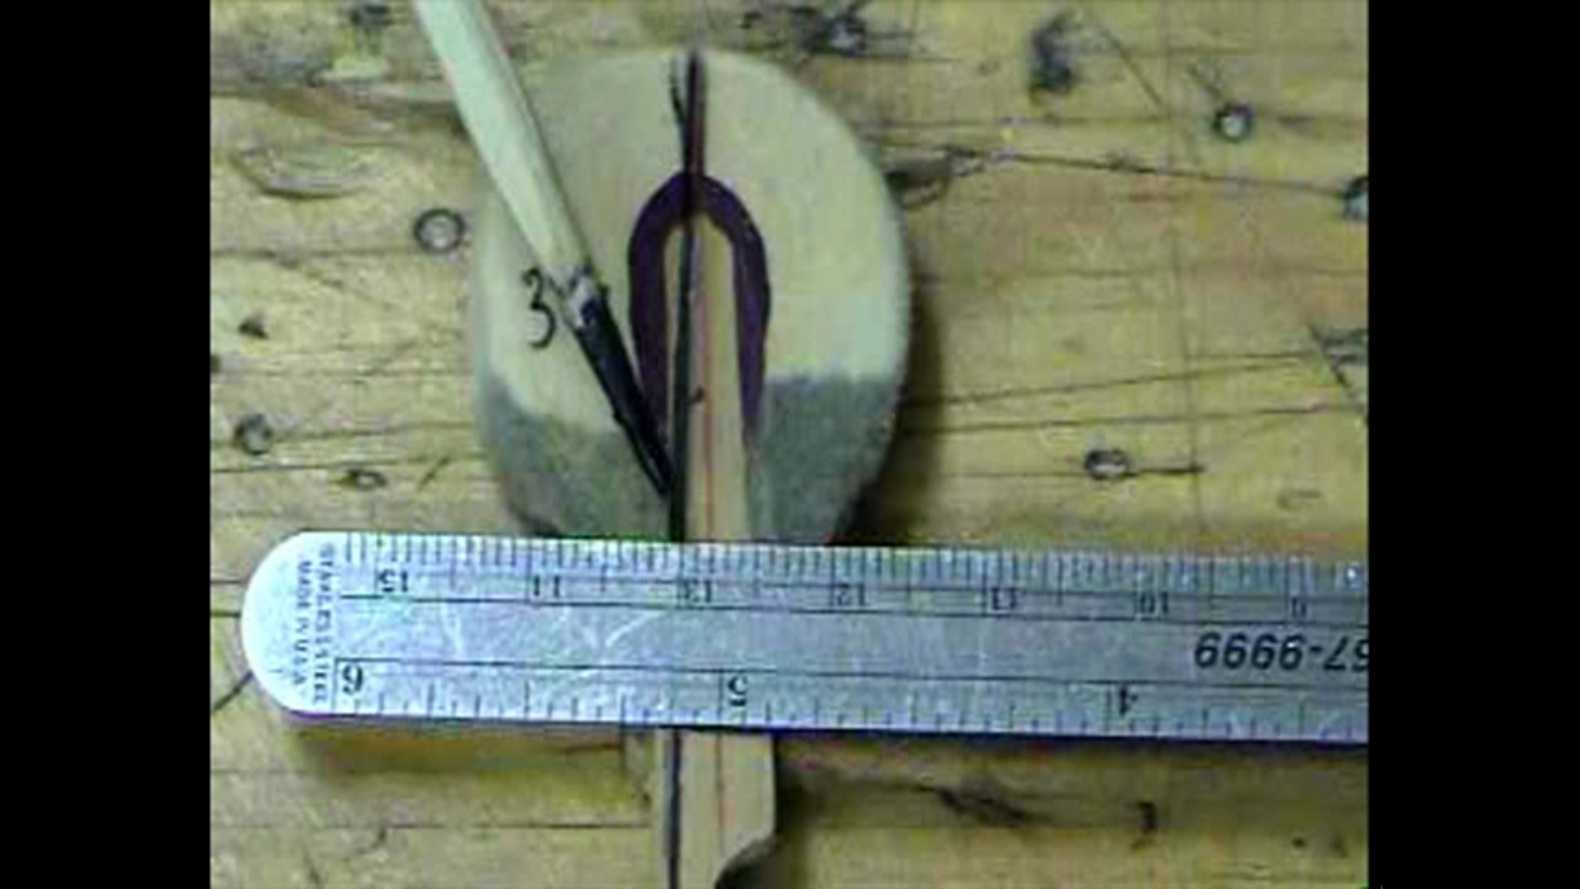

Slide 9
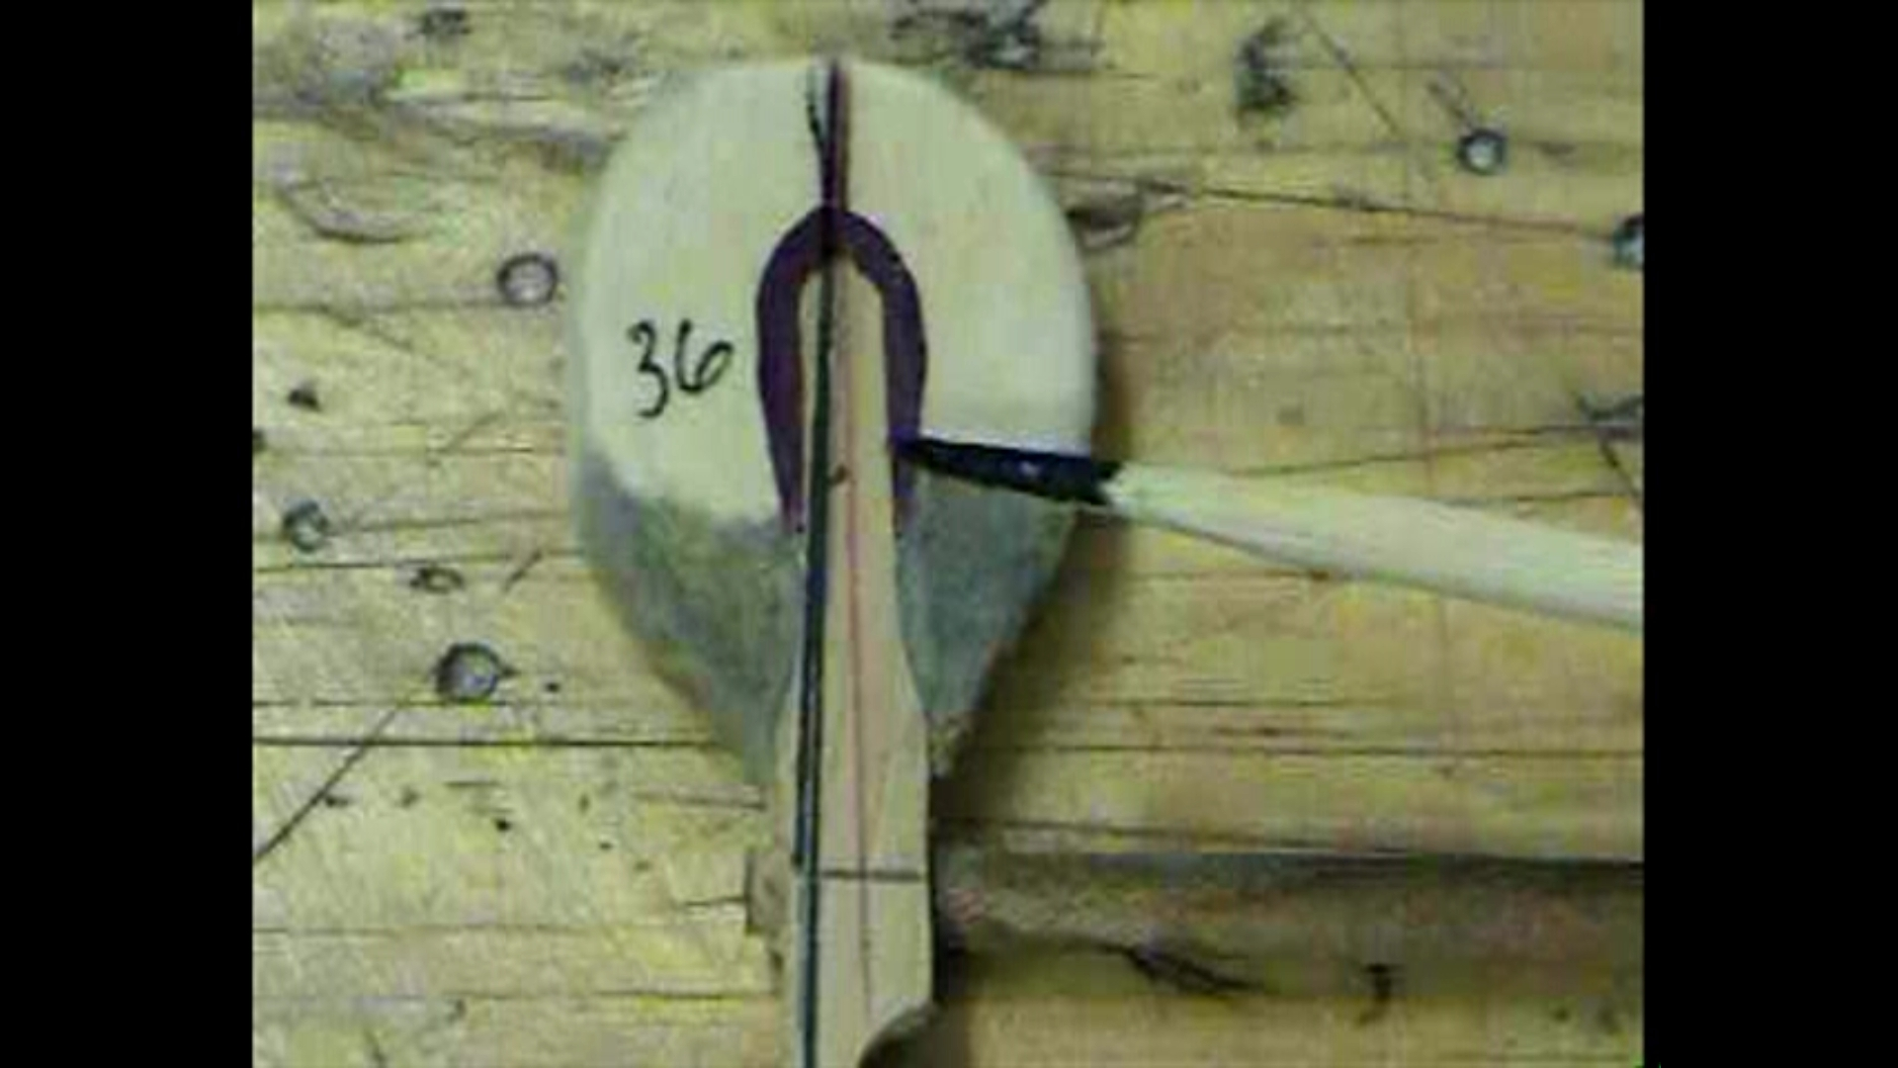
Green line is 90° to shank.
This line should be the
hammer center line
Hammer center line
Shank center line

Slide 10


Slide 11
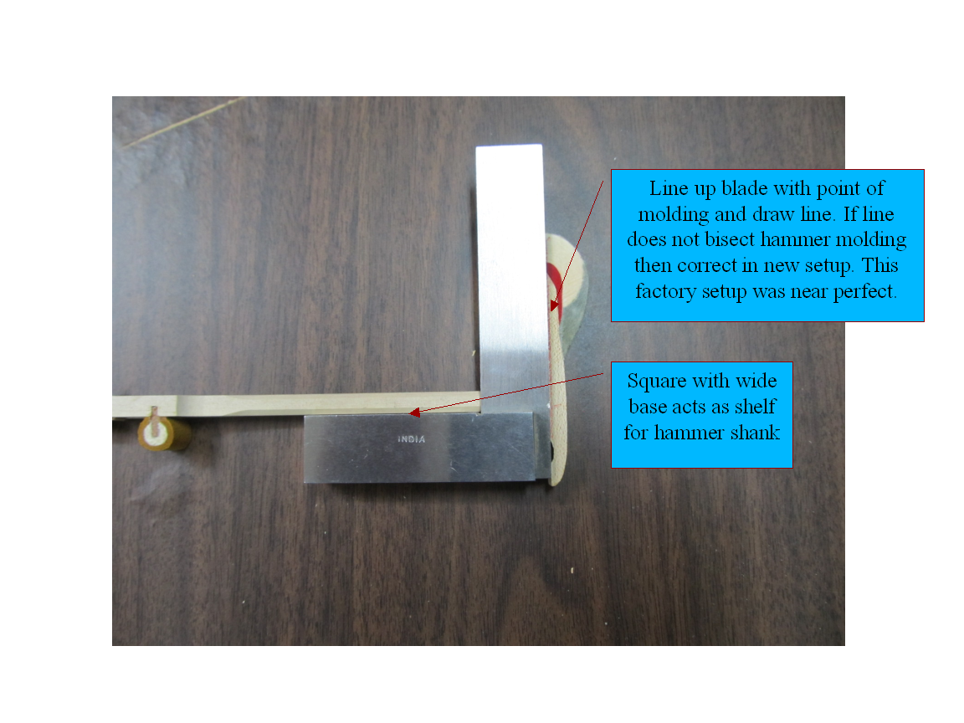

Slide 12
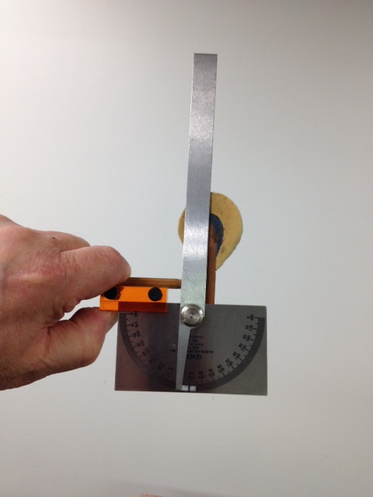

Slide 13
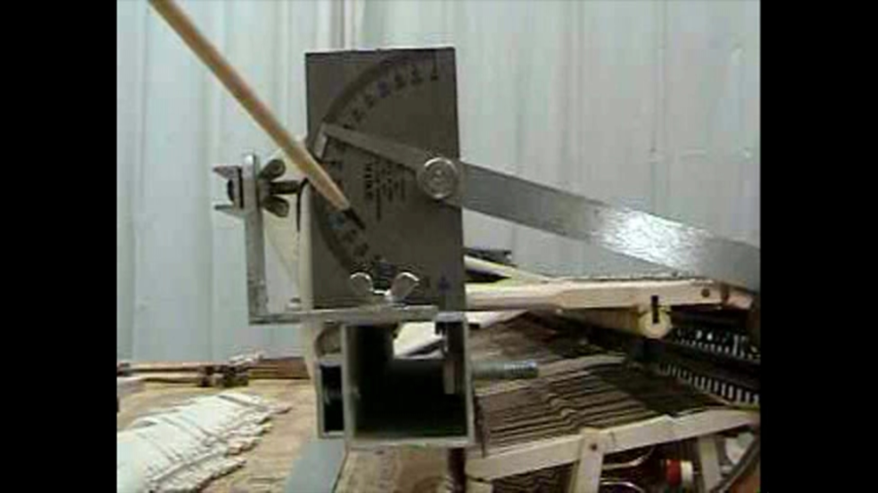

Slide 14
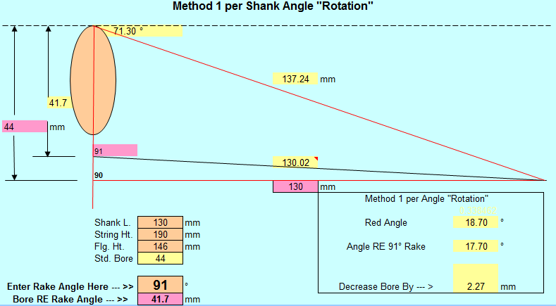
Hammer Rake Change

Slide 15
Action Elevations
Especially the hammer shank center pin to the keybed.

Slide 16
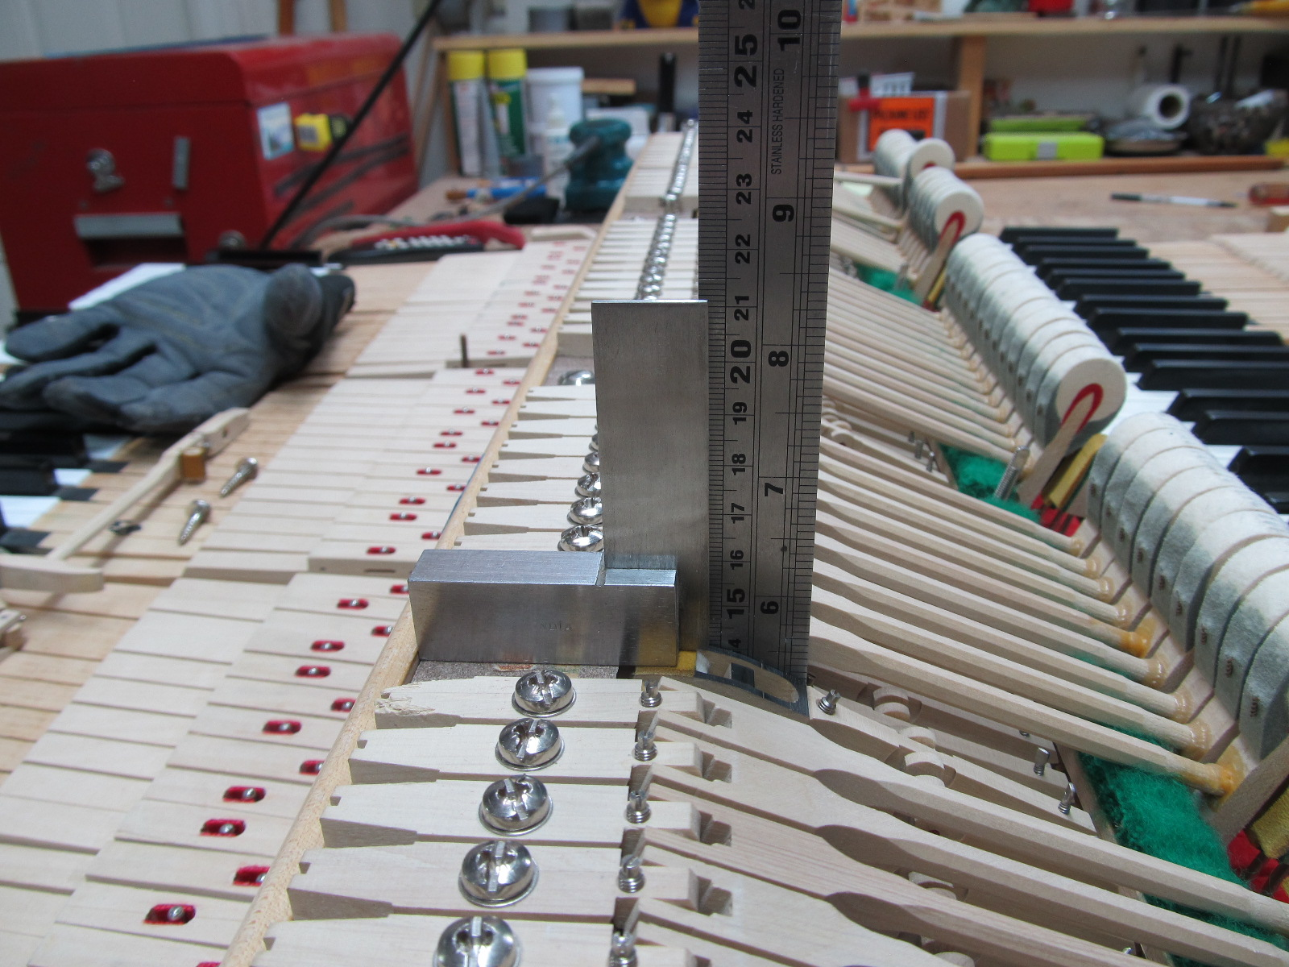
Make sure that the ruler contacts the workbench, and not a cross rail of the action frame!

Slide 17
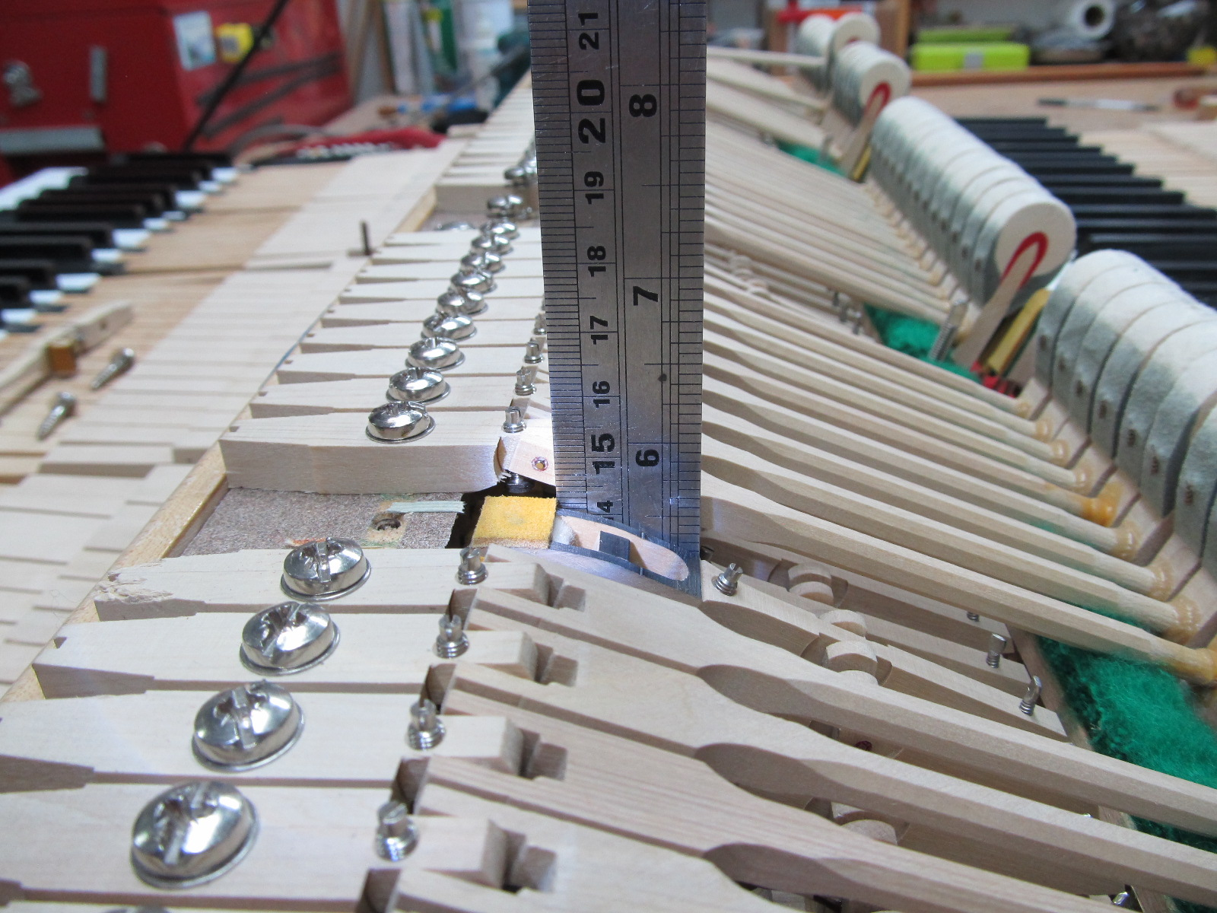
Baldwin 9’ grand. Center pin is 148 mm from keybed (workbench).

Slide 18
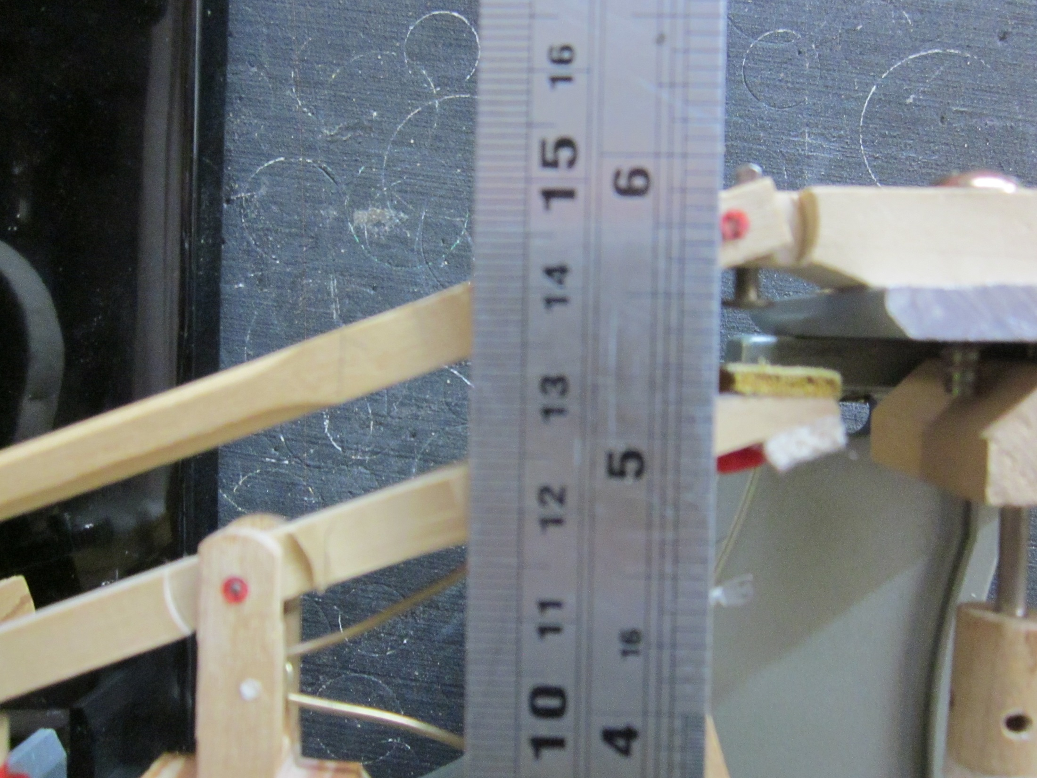
Center pin height is 5.75” or 146mm, typical of many pianos such as Steinway

Slide 19
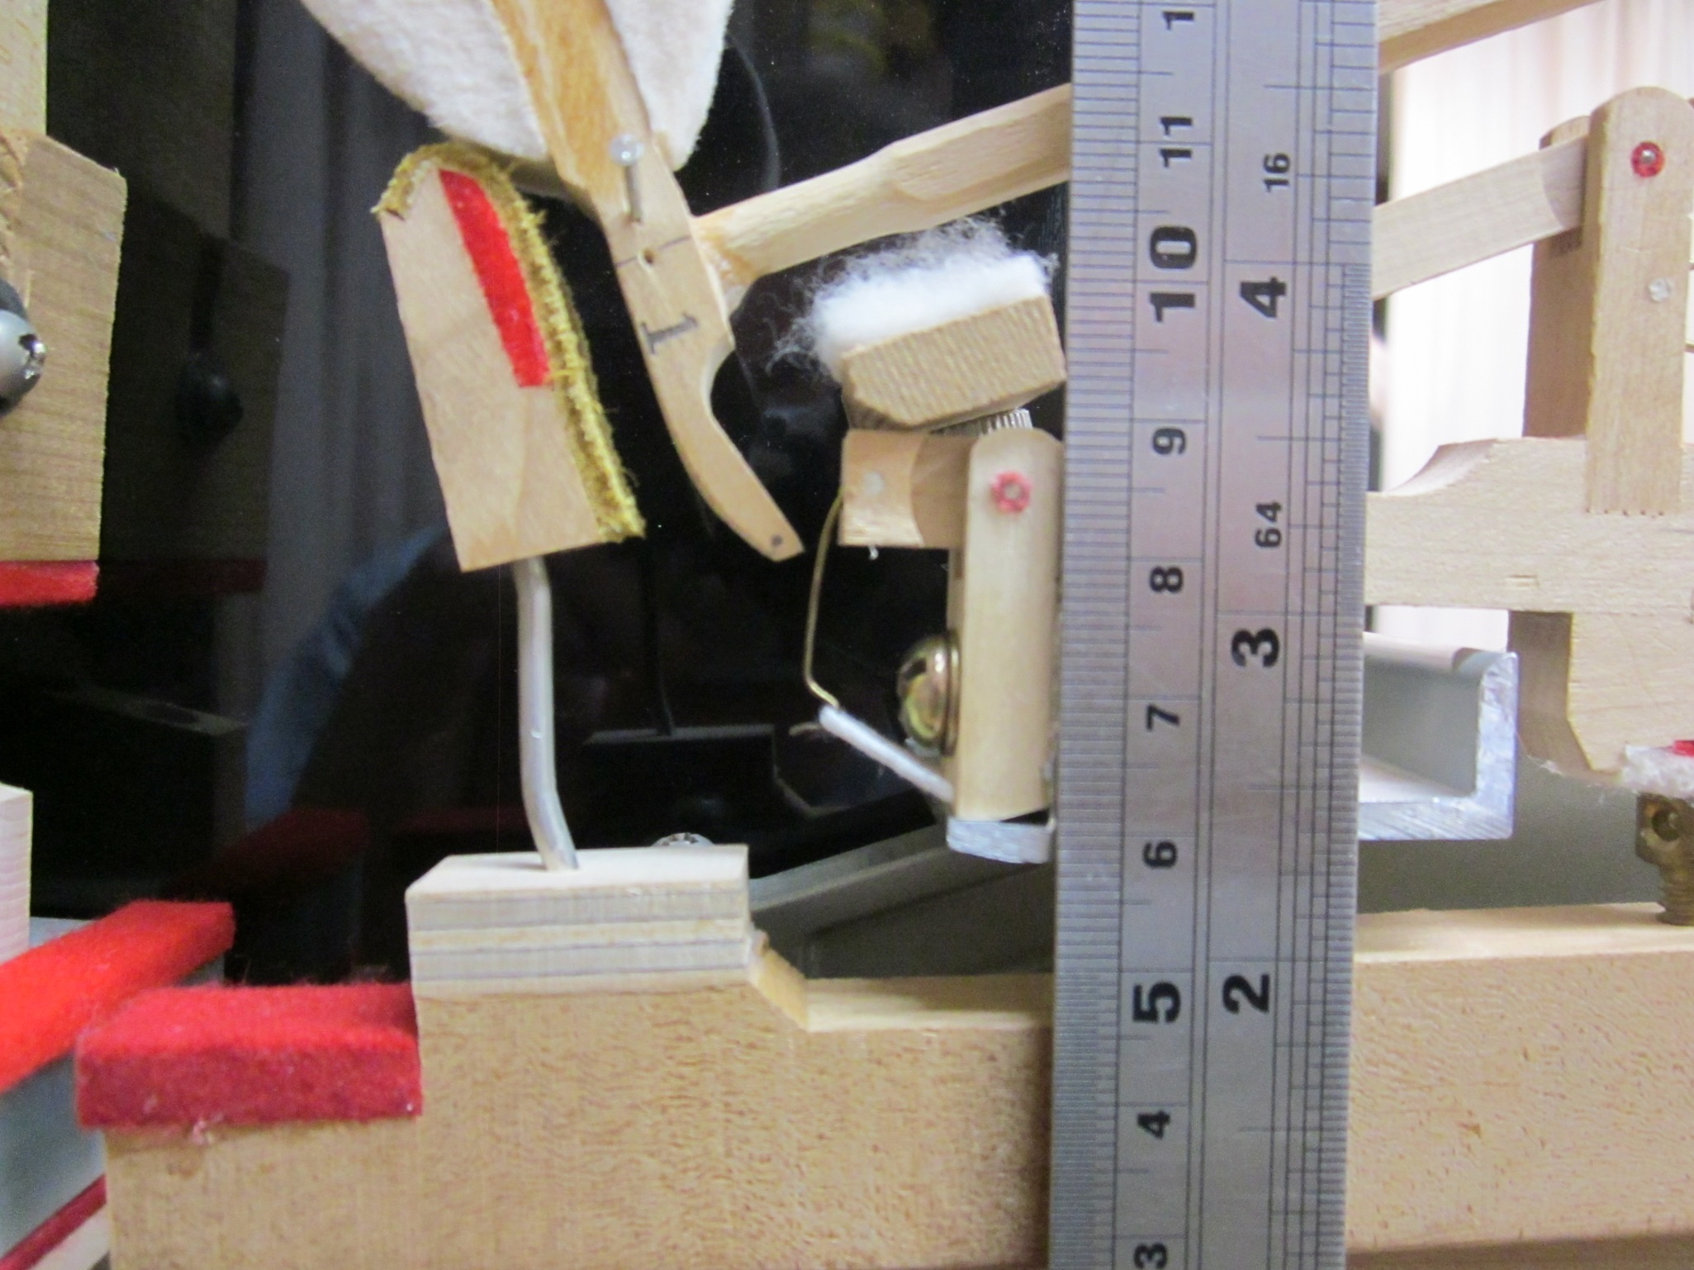
Wip center pin height is 3- 5/16” or 84mm. The Steinway spec is 3- ¼” or 82.5mm

Slide 20
Action and String Plane Elevations
Steinway and many others:
Keybed to hammer flange center 5.75” (146mm)
Keybed to wip flange center 3.25” (82.6mm)
Keybed to capo bar at note 62 is 7.5” (190.5mm)
  Mdl. D is 7.625” (194mm)
  Mdl. D action elevations proportionally higher as shown earlier on the Baldwin D action.

Slide 21
END

